Slide 1
Astro 331 Lesson 9
Digital Logic & Breadboarding
Supp Crs Mtl

Slide 2
Lesson Objectives
Construct the truth table corresponding to a scenario described in words
Apply Boolean algebra to simplify a Boolean expression
Using AND, OR, and NOT gates, construct a graphical representation of a Boolean expression

Slide 3
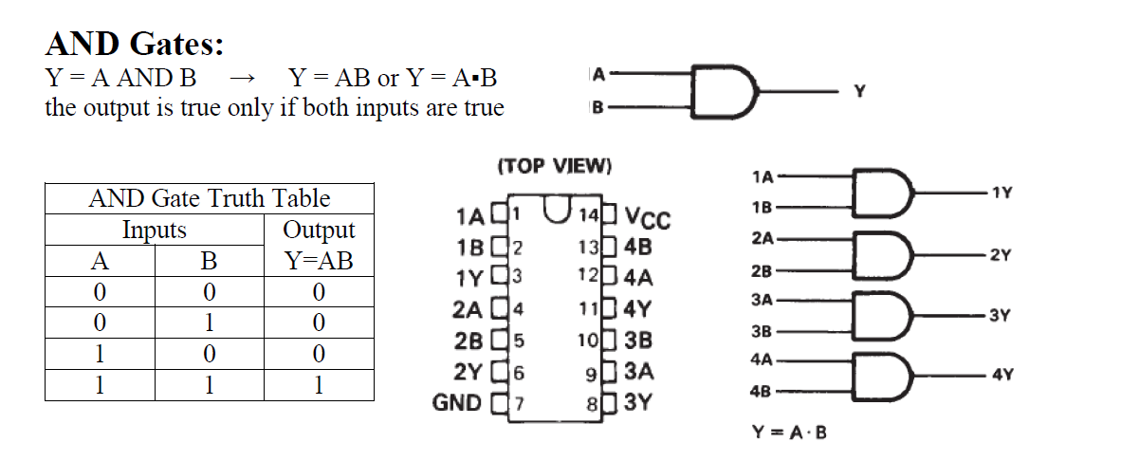

Slide 4
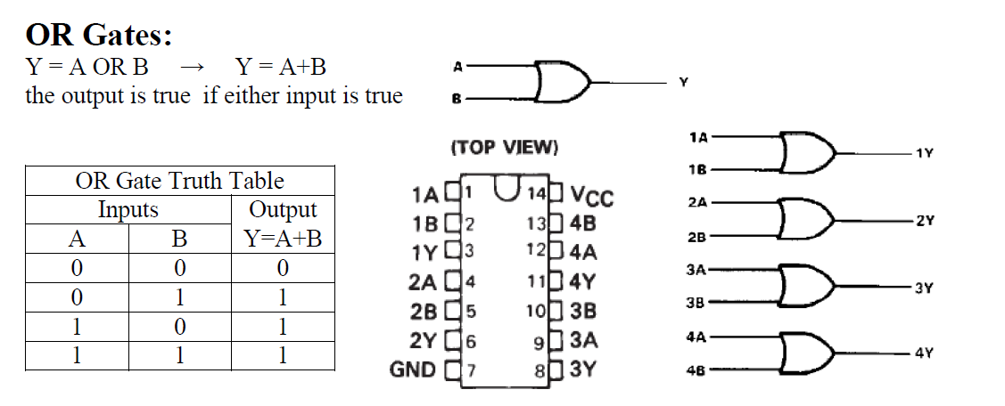

Slide 5
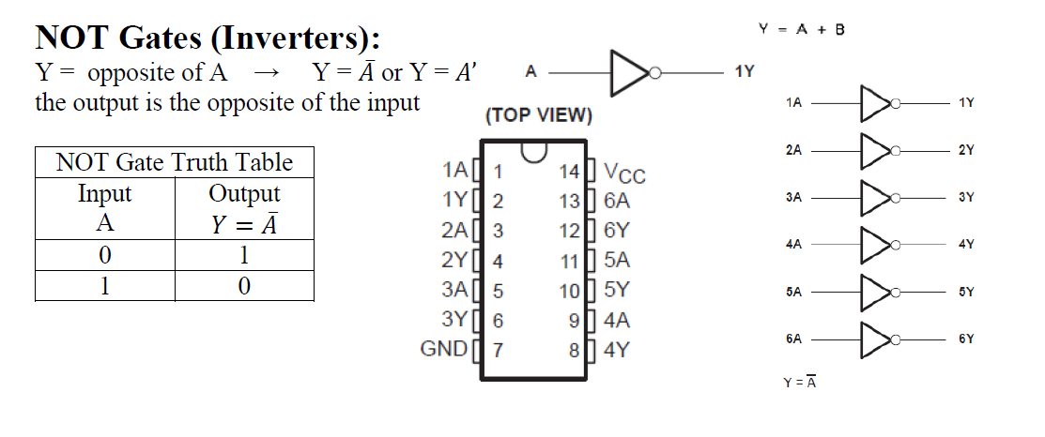

Slide 6
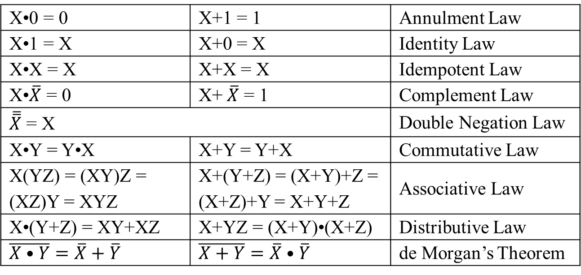
Boolean Algebra Laws & Theorems
X•0 = 0 | X+1 = 1 | Annulment Law
X•1 = X | X+0 = X | Identity Law
X•X = X | X+X = X | Idempotent Law
X•$\overline{X}$ = 0 | X+$\overline{X}$ = 1 | Complement Law
$\overline{\overline{X}}$ = X |  | Double Negation Law
X•Y = Y•X | X+Y = Y+X | Commutative Law
X(YZ) = (XY)Z = (XZ)Y = XYZ | X+(Y+Z) = (X+Y)+Z = (X+Z)+Y = X+Y+Z | Associative Law
X•(Y+Z) = XY+XZ | X+YZ = (X+Y)•(X+Z) | Distributive Law
$$\overline{X•Y}=\overline{X}+\overline{Y}$$ | $$\overline{X+Y}=\overline{X}•\overline{Y}$$ | de Morgan’s Theorem

Slide 7
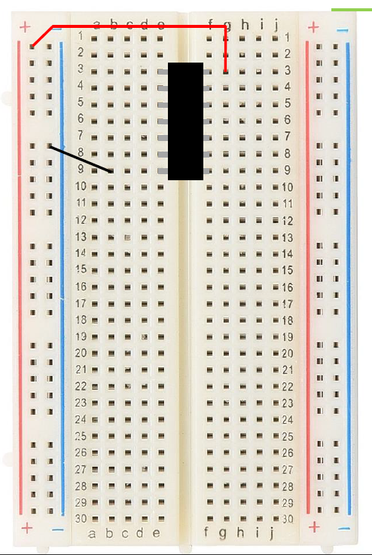

Slide 8
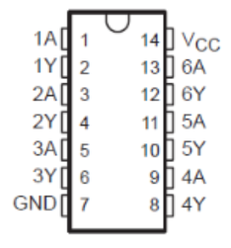
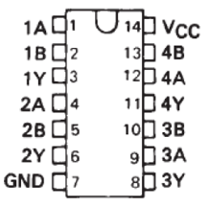
Breadboard Layout
OR
NOT
AND
AND

Slide 9
Example
Create a truth table that represents all possible scenarios for wanting to buy a coke from a vending machine.
First item: vending machine must have a coke in stock
Second item: I must have exact change
Third item: I must have a dollar bill
Then, present the Boolean algebra statement that represents all scenarios that result in success and draw a logical schematic that illustrates that statement.

Slide 10
Solution (1/3)
Inputs |  |  | Output
In Stock A | Exact Change B | Dollar Bill C | Coca Cola Y = A(B+C)
0 | 0 | 0 | 0
0 | 0 | 1 | 0
0 | 1 | 0 | 0
0 | 1 | 1 | 0
1 | 0 | 0 | 0
1 | 0 | 1 | 1
1 | 1 | 0 | 1
1 | 1 | 1 | 1
Success: $A\overline{B}C+AB\overline{C}+ABC$

Slide 11
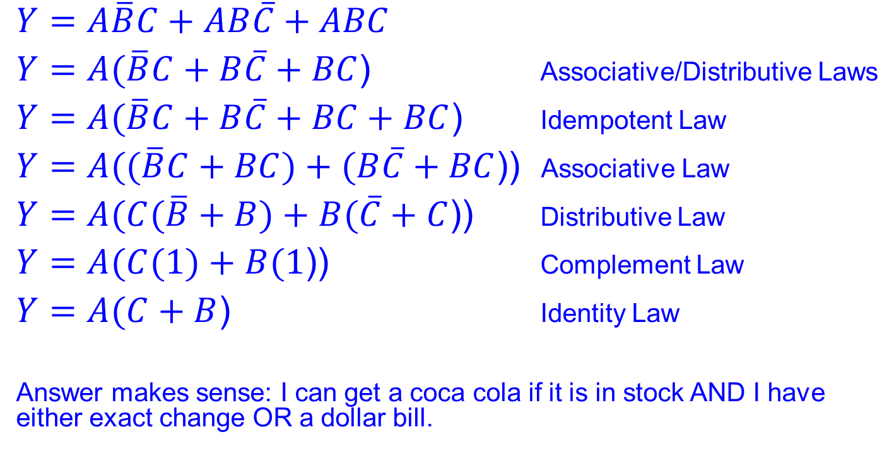
Solution (2/3)
$Y=A\overline{B}C+AB\overline{C}+ABC$
$Y=A(\overline{B}C+B\overline{C}+BC$) Associative/Distributive Laws
$Y=A(\overline{B}C+B\overline{C}+BC+BC$) Idempotent Law
$Y=A((\overline{B}C+BC)+(B\overline{C}+BC$)) Associative Law
$Y=A(C(\overline{B}+B)+B(\overline{C}+C$)) Distributive Law
$Y=A(C(1)+B(1$)) Complement Law
$Y=A(C+B$) Identity Law
Answer makes sense: I can get a coca cola if it is in stock AND I have either exact change OR a dollar bill.

Slide 12
Solution (3/3)
Schematic from simplified Boolean expression:
A
Y = A(B+C)
B
(B+C)
C
Requires:
1 AND Gate
1 OR Gate
0 NOT Gates

